Slide 1
Writing large numbers in standard form
Task A: Writing large numbers in standard form
Without using a place value chart, convert the following into standard form.
15 000
566 000 000
9 800 000 000
156 100
563 000 000 000 000 000
100 200 000 000
2) Three pupils we give 905 000 000 000 to convert to standard form. Identify where they made their error and give the correct answer.
905 000 000 000
Answer: 905 × 10⁹
905 000 000 000
Answer: 9.5 × 10¹¹
905 000 000 000
Answer: 9.05 × 10¹⁰
3) Explain why standard form is important.

Slide 2
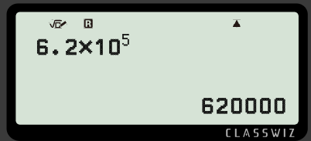
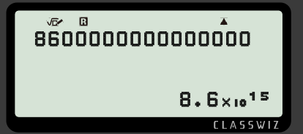
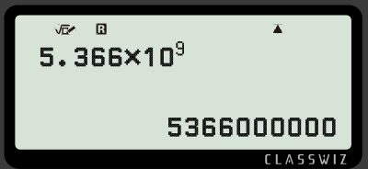
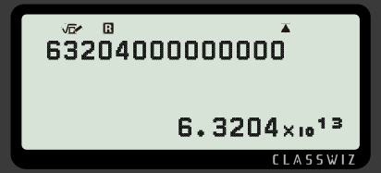
Writing large numbers in standard form
Task B: Standard form to ordinary
Write the following as ordinary numbers.
1.8 × 10³
1.39 × 10⁵
3.93 × 10⁷
4.413 × 10⁸
e) 8.02 × 10³
f) 5.001 × 10⁵ g) 1.2345 × 10⁷ h) 7.00004 × 10⁸
Task C: Standard form on the calculator
Fill in the missing information.
a)
c)
b)
d)
2) Investigate when the number becomes so big that the calculator converts it into standard form.
Mathematics in Education and Industry
v2.3

